Slide 1

City of Providence / Providence Public School Department
Teachers’ Benefits Workshop
Thursday, September 15, 2016

Slide 2
Agenda
Introduction and Welcome – Margaret Wingate, City of Providence
Plan Comparison HMCTC & HMCTC Plan 750
  Medical - BCBSRI
  Cost - Margaret Wingate – City of Providence
ACA Update Preventive Services – Margaret Wingate, COP
Questions

Slide 3
BCBSRI Medical Plan Comparison
HMCTC and Plan 750

Slide 4
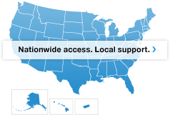
Unparalleled Access to Care
  Our BlueCard® PPO national network of doctors and specialists gives you access to thousands of providers across the country, including:
  96 percent of medical providers in Rhode Island
  More than 665,000 doctors and specialists nationwide
  And more than 5,300 hospitals across the country

Slide 5
Groups Covered | Healthmate No Deductible Plan |  | Healthmate $750 Deductible Plan
Types of Coverage | Network Benefits Non-Network Benefits |  | Network Benefits Non-Network Benefits
Deductible | Single: None Family: None | $4000/$8000 No one member will exceed $4000 | $750/$1500 No one member will exceed $750 | $750/$1500 No one member will exceed $750
Co-Insurance | BCBS pays 100% | BCBS pays 80% | BCBS pays 100% | BCBS pays 80%
Out-of-Pocket Max | $4000/$8000 No one member will exceed $4000 | $6350/$12,7000 No one member will exceed $6350 | $4000/$8000 No one member will exceed $4000 | $5000/$10,000 No one member will exceed $5000
Office Visits | Annual $0 copay PCP & Spec $10 Allergy & Derm $15 | $10 copay plus 20% $10 copay plus 20% $15 copay plus 20% | Annual $0 copay PCP & Spec $30 Allergy & Derm $30 | $30 copay plus 20% $30 copay plus 20% $30 copay plus 20%
Hospital – Facility In-patient/Out-patient Medical/surgical | BCBS pays 100% | BCBS pays 80% | BCBS pays 100% after deductible | BCBS pays 80% after the deductible
Emergency Room (Waived if admitted) | $100 co-pay Annual Max per year $200 / $300 family | $100 co-pay Annual Max per year $200 I/ $300 family | $100 co-pay | $100 co-pay
Behavioral Health Mental Health & Chemical Dependency | Inpatient 100% $10 co-pay for Office visits | Inpatient 80% after deductible $10 co-pay plus 20% | Inpatient 100% after deductible $15 co-pay for Office visits | Inpatient 80% after deductible $15 co-pay plus 20%
Diagnostic Lab, x-ray, machine Tests, Imaging and Sleep studies | BCBS pays 100% | BCBS pays 80% after deductible | BCBS pays 100% after deductible | BCBS pays 80% after deductible

Slide 6
Deductibles, Co-pays and Co-Ins.
Deductible – the amount you pay before your health plan starts to pay its share of certain medical bills.
Co-pay – a fixed amount, not percentage, charged each time a member receives a healthcare service
Co-insurance – a member pays a percentage of the total medical bill

Slide 7
Services Subject to Deductible
 | In-Network Per Individual Plan | In-Network Per Family Plan
Deductible | $750 | $1500
Out-of-Pocket Maximum | $4,000 | $8,000
What You Pay | In-Network Service
0% after deductible | In-patient & Outpatient medical/surgical care
0% after deductible | High-end radiology services (e.g. MRI/CAT) and nuclear medicine, lab, x-rays, and machine tests
0% after deductible | Skilled Nursing Facility Care
20% after deductible | Durable medical equipment
20% after deductible | Physical/occupational/speech therapy
This is a summary of your HealthMate Coast to Coast benefits. For details about your coverage, including any limitations or exclusions not noted here, please refer to your Subscriber Agreement or call our Customer Service Department.

Slide 8
Services with a Copayment on $750 Plan
What You Pay | In-Network Service
$30 per visit | Primary care office visits
$30 per visit | Specialist office visits Specialty care Chiropractic (limit 12 visits per year) Routine eye exam (limit 1 visit per year)
$50 per visit | Urgent care center visits
$100 per visit | Emergency room care Waived if admitted within 24 hours If admitted, the deductible does apply

Slide 9
Services with a Copayment on the NO Deductible in-Network Plan
What You Pay | In-Network Service
$10 per visit | Primary care office visits
$10 per visit | Specialist office visits Specialty care ( except Allergy and Dermatology $15) Chiropractic (limit 12 visits per year) Routine eye exam (limit 1 visit per year)
$10 per visit | Urgent care center visits
$100 per visit | Emergency room care Waived if admitted within 24 hours If admitted, the deductible does apply Annual max $200 per Ind/$300 family per cal yr.

Slide 10
Great Benefits.
From a Company That’s Here to Serve You.
Learn what to expect from Blue Cross & Blue Shield of Rhode Island health plans and services
Read the Member Handbook on BCBSRI.com
The Member Handbook (BCBSRI.com/planinfo) contains important information about:
How to find a doctor
How to get emergency and after-hours care
How to get interpreter services
Copays, coinsurance, and deductibles
Policy limitations and exclusions
How your health information is protected
Where to access a summary of covered and non-covered benefits
Our utilization management program
Case and disease management programs
Visit BCBSRI.com
In addition to the member handbook, you can find other important information on our award-winning Website, including:
Specific Plan Options
  Covered and non-covered benefits*
  The covered drug list (formulary), which changes every April and October
  How to save money with generic drugs
  Pharmacy information such as quantity limits or other restrictions
The Value of Blue
  Our initiatives, programs and commitment to diversity and social responsibility
  How we can best serve you
Members can also log in to take advantage of personalized tips and interactive tools to helps improve your health or manage chronic conditions
*For a complete list of covered benefits and limitations and exclusions, please refer to your subscriber agreement/ benefit booklet.

Slide 11
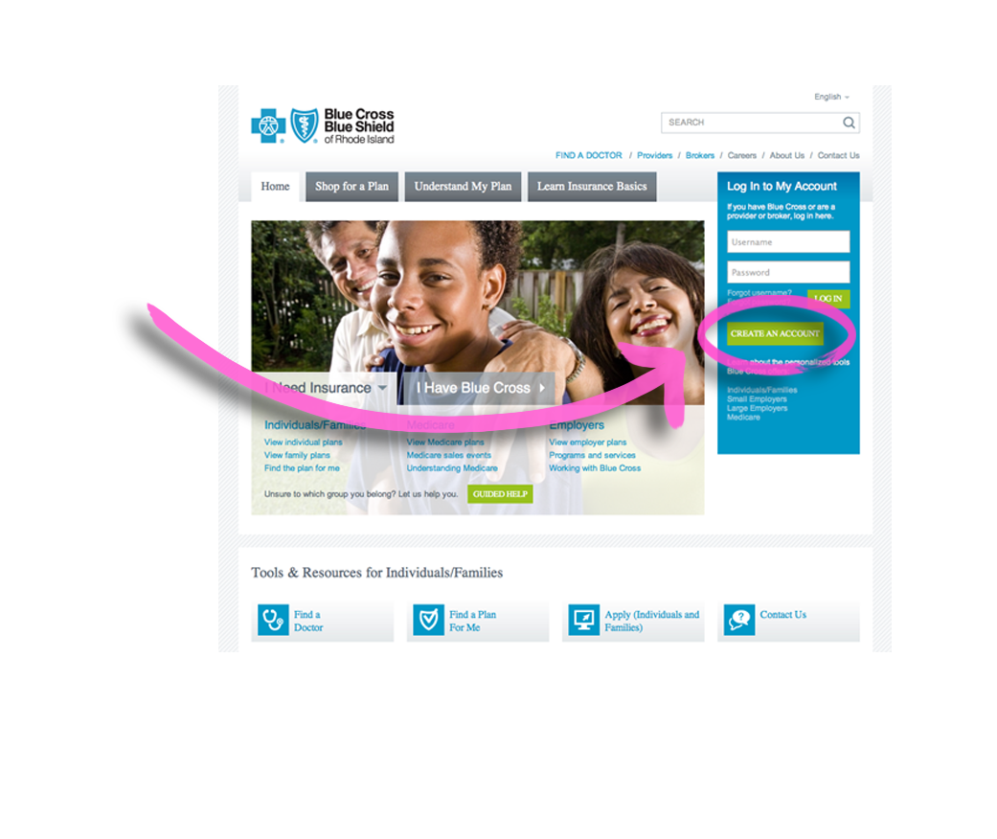
Registering on BCBSRI.com
Go to BCBSRI.com
and click “Create An Account” on the
right-hand side of
the page
Follow the registration
instructions

Slide 12
Annual Co-Shares Teachers Hired After 8/31/04 (per 09-01-14 to 08-31-17 CBA)
Coverage Level | HMCTC | HMCTC Plan 750 | Co-Share Difference
Individual | $2,593.88 Annually | $1,224.71 Annually | $1,369.17 Annually
 | $123.52 per 21 paychecks | $58.32 per 21 paychecks | $65.20 per 21 paychecks
Family | $7,140.09 Annually | $3,214.95 Annually | $3,925.14 Annually
 | $340.00 per 21 paychecks | $153.09 per 21 paychecks | $186.91 per 21 paychecks
REMINDER: OPEN ENROLLMENT IS HAPPENING NOW!
Open enrollment is currently in effect for all active Providence School Department employees. Now is the time to make changes to your health insurance if you choose to. Open Enrollment will take place from Thursday, September 1, 2016 through Friday, September 30, 2016.

Slide 13
Annual Co-Shares Teachers Hired Before 8/31/04 (per 09-01-14 to 08-31-17 CBA)
Coverage Level | HMCTC | HMCTC Plan 750 | Co-Share Difference
Individual | $1,505.75 Annually | $0.00 Annually | $1,505.75 Annually
 | $71.70 per 21 paychecks | $0.00 per 21 paychecks | $71.70 paychecks
Family | $4,020.67 Annually | $0.00 Annually | $4,020.67 Annually
 | $191.46 per 21 paychecks | $0.00 per 21 paychecks | $191.46 per 21 paychecks
REMINDER: OPEN ENROLLMENT IS HAPPENING NOW!
Open enrollment is currently in effect for all active Providence School Department employees. Now is the time to make changes to your health insurance if you choose to. Open Enrollment will take place from Thursday, September 1, 2016 through Friday, September 30, 2016.

Slide 14
Preventive Services - Update
BCBSRI Medical * | CVS Caremark Prescription
Annual Well Check-Up | Tier 1 and Over the Counter (OTC) contraceptives for women (oral and non-oral)
Annual OB/GYN exam for women | Smoking Cessation Medication (OTC and Rx; mostly only generic products)
Immunization vaccines when administered at a physician’s office (Hep A & B, HPV, Flu, Measles, Mumps, Rubella, Chicken Pox, Teanus, etc.) | Vitamin D, Iron Supplements, and Fluoride Supplements
Breast Cancer screening for women | Generic Folic Acid (for women)
Colorectal Cancer Screening (for adults over the age of 50) | Primary Prevention of Breast Cancer (generic only)
Cervical cancer screening (Pap test) for women | Bowel Prep Medication
Prostrate-specific antigen (PSA test) for men | OTC and Generic Aspirin
Tobacco cessation counseling | Immunization Vaccines for Adults and Children
Blood Pressure and Cholesterol Screening
Screenings for STD, Lung Cancer, obesity, Type 2 Diabetes, etc.
Alcohol misuse screening and counseling
* You can also search on BCBSRI website for covered preventive services

Slide 15
The City of Providence/PPSD Employee & Retiree Benefits Department is a centralized, one-stop resource for benefits enrollment, information and assistance. We offer assistance to employees & retirees in the following areas:
Health Plans
  Medical
  Dental
  Prescription
Coordination of Benefits (COB) Initiative
Flexible Spending Accounts (FSA)
Maintenance Choice/90 day prescriptions
Open Enrollment
Claims/Billing Questions
Medical, Prescription, Dental ID Cards
Wellness Initiatives
Adding/Removing Dependents from Coverage; Opting out of coverage
Specific Benefit Questions: Flu Shots, Diabetic Supplies, Durable Medical Equipment
Comparison between Teacher Health Plans (Health mate v. 750 Deductible Plan)
Affordable Care Act (ACA) Compliance & Summary of Benefits & Coverage (SBC’s)
The Employee Benefits Department is available to assist employees by phone, email, on a walk-in basis, and for scheduled appointments. We are located on the 4th floor of Providence City Hall. We are also happy to meet you at a location that is convenient to you by appointment.
Name/Location | Focus | Contact Information
John Glascom - City Hall | Active Employees | (401) 680-5281 or jglascom@providenceri.gov
Toni Barletta - City Hall | Retirees | (401) 680-5285 or tbarletta@providenceri.gov
Margaret Wingate - City Hall | Manager of Benefits | (401) 680-5535 or mwingate@providenceri.gov
Claire Girard - City Hall | Benefits Specialist | (401) 680-5535 or cgirard@providenceri.gov
Benefits Email | General Inquiries | benefits@ppsd.org

Slide 16
QUESTIONS?

